Slide 1
C-DAC ASSIGNMENT ONE
Problem: Estimating Pi using Monte Carlo Method

Slide 2
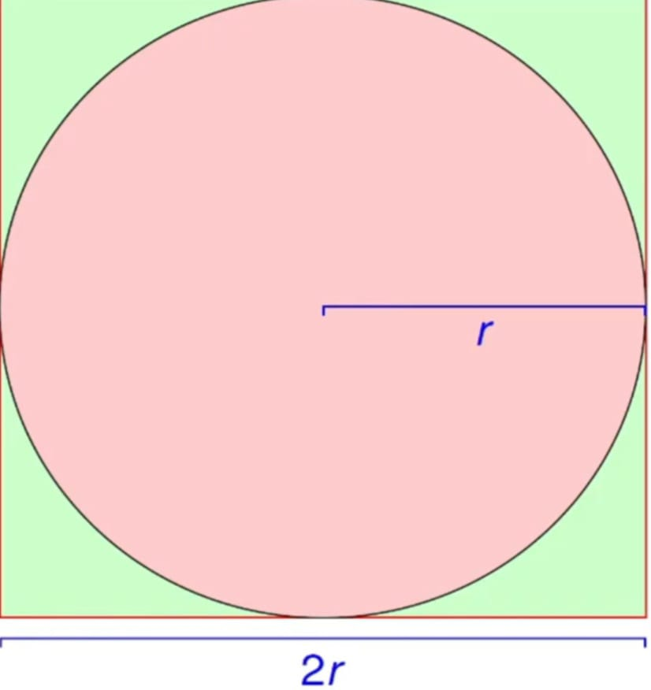
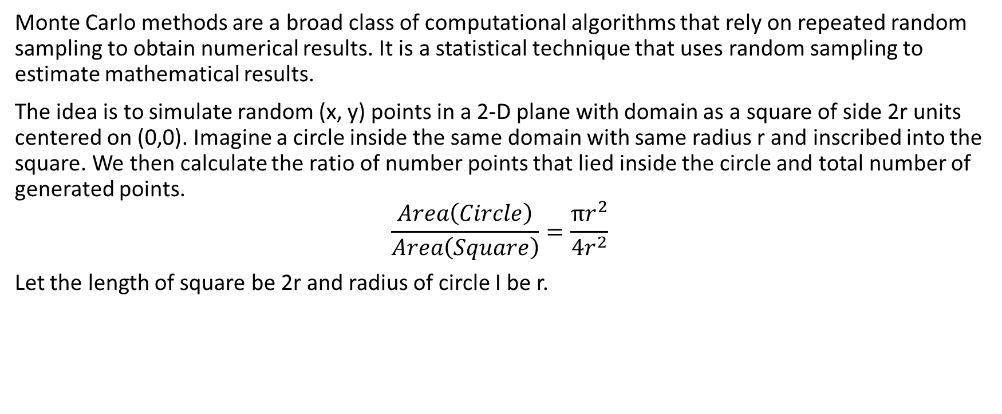
Introduction
Monte Carlo methods are a broad class of computational algorithms that rely on repeated random sampling to obtain numerical results. It is a statistical technique that uses random sampling to estimate mathematical results.
The idea is to simulate random (x, y) points in a 2-D plane with domain as a square of side 2r units centered on (0,0). Imagine a circle inside the same domain with same radius r and inscribed into the square. We then calculate the ratio of number points that lied inside the circle and total number of generated points.
$$\frac{Area\left(Circle\right)}{Area\left(Square\right)}=\frac{πr^{2}}{4r^{2}}$$
Let the length of square be 2r and radius of circle I be r.

Slide 3
Concepts Used:
1). Serial Computing
Problem is broken into stream of instructions that are executed sequentially one after the other on a single processor
One instruction executes at a time.
2). Parallel Computing
Problem is broken into parts that can be solved concurrently.
Each part is further broken into a stream of instructions.
Instructions from different parts execute simultaneously on different processors.
3). Open Multiprocessing
It is an API for shared memory model programming.
Runtime Library routines(e.g: omp_get_num_threads())
Environment Variables(e.g: OMP_NUM_THREADS)
It is easy to use than MPI
It is thread based
- Fork-Join model

Slide 4
Implementation of Serial Version:
#include <stdio.h>
#include <stdlib.h>
#include <time.h>
int main() {
long long int num_points, count_inside = 0;
double x, y, pi;
printf("Enter number of random points: ");
scanf("%lld", &num_points);
clock_t start = clock();
for (long long int i = 0; i < num_points; i++)
{
x = (double)rand() / RAND_MAX;
y = (double)rand() / RAND_MAX; //32767
if ((x * x + y * y) <= 1.0)
{
count_inside++; x^2 + y^2 <=1.0
}
}

Slide 5
pi = 4.0 * count_inside / num_points;
clock_t end = clock();
double time_taken = (double)(end - start) / CLOCKS_PER_SEC;
printf("Estimated Pi = %.5f\n", pi);
printf("Execution time = %.2f seconds\n", time_taken);
return 0;
}

Slide 6
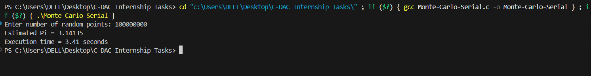
Outcome:

Slide 7
Implementation of Parallel Version:
Para-shell.sh:
#!/bin/bash
echo "Running 4 Monte Carlo simulations in parallel (2 threads each)..."
for i in {1..4}
do
./pi <<< 100000000 &
Done
Wait
echo "All 4 simulations completed.“
pi.c:
<#include <stdlib.h>
#include <omp.h>
#include <unistd.h>
int main()
{
long long int num_points;
printf("Enter number of random points: ");
scanf("%lld", &num_points);
long long int count_inside = 0;

Slide 8
double pi;
double start = omp_get_wtime();
omp_set_num_threads(2);
#pragma omp parallel
{
unsigned int seed = 1234 + omp_get_thread_num();
long long int local_count = 0;
double x, y;
#pragma omp for
for (long long int i = 0; i < num_points; i++) {
x = (double)rand_r(&seed) / RAND_MAX;
y = (double)rand_r(&seed) / RAND_MAX;
if ((x * x + y * y) <= 1.0)
local_count++;
}

Slide 9
#pragma omp atomic
count_inside += local_count;
}
pi = 4.0 * count_inside / num_points;
double end = omp_get_wtime();
printf("PID: %d | Estimated Pi = %.5f | Time = %.6f sec\n", getpid(), pi, end - start);
return 0;
}

Slide 10
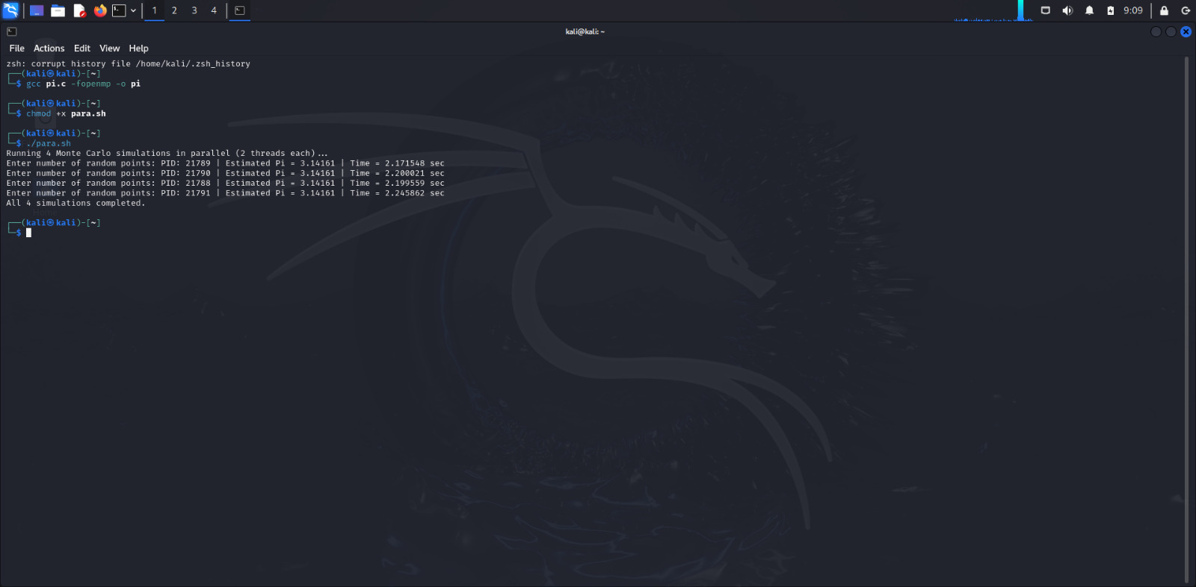
Outcome:

Slide 11
References:
1. Introduction to Parallel Computing by NPTEL:
https://youtube.com/playlist?list=PLp6ek2hDcoNBAyEJmxsOowMYNTKsUmTZ8&si=ZmofbY6xe8cYhhz-
2. Monte Carlo method:
https://youtu.be/qcWg59jvqeA?si=oAoYKjFrnLPpYl9w
3. GeeksForGeeks:
https://www.geeksforgeeks.org/estimating-value-pi-using-monte-carlo/

